Slide 1

IBM HR Analytics Employee Attrition & Performance
Uche Obianyimuo, jack Ozcelik & Sarai EMbaye

Slide 2
Purpose of the Project
Purpose:
Analyze correlations within the dataset to determine attrition trends.
Scope:
Data source:
https://www.kaggle.com/pavansubhasht/ibm-hr-analytics-attrition-dataset
Resources:
https://matplotlib.org/3.2.0/gallery/lines_bars_and_markers/barchart.html#sphx-glr-gallery-lines-bars-and-markers-barchart-py
Jupyter notebook
Github
Pandas

Slide 3
Analytical Questions for the Data Set
Is there a significant difference when it comes to male or female in the job performance?
If so, what major trends in other areas of job satisfaction, benefits and work/life satisfaction. Are there any outliers?
What is the correlation between performance rating and type of role?
How many employees report that job satisfaction is high but work/life balance is low?
Does types of assertions can we make regarding the data?
There are discussions regarding that companies do not provide the same benefits in terms of retirement pension and health benefits. More employees seem to be switching jobs at an alarming rate. What is the average age distribution verses average time at the company?
Does the data show any relationship between ‘Educational Level’ versus ‘Employee Retention’?
Any relationship between ‘Attrition’ and ‘Department’? ‘Attrition’ versus ‘Education Field’? Etc.
Any further questions

Slide 4
Data visualization & Analysis

Slide 5
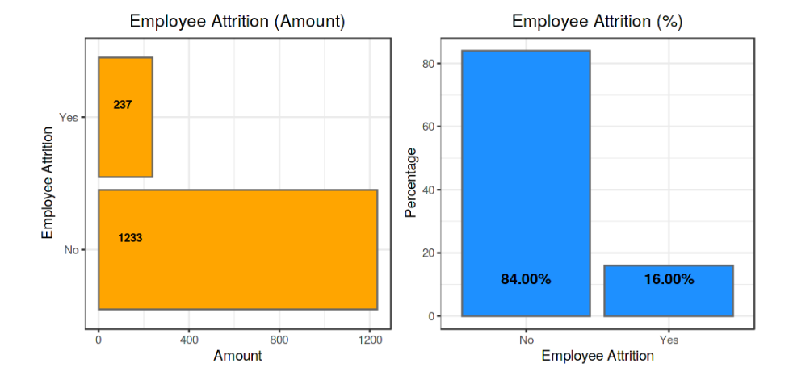


Slide 6
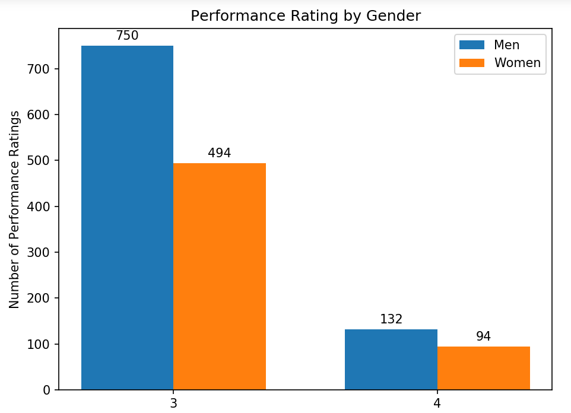
Is there a difference in gender that would cause us to see an attribution between male and female

Slide 7
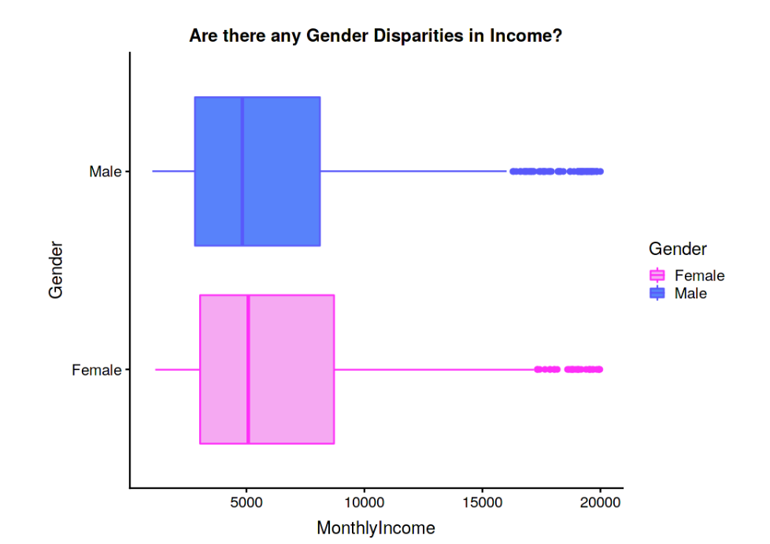

Slide 8
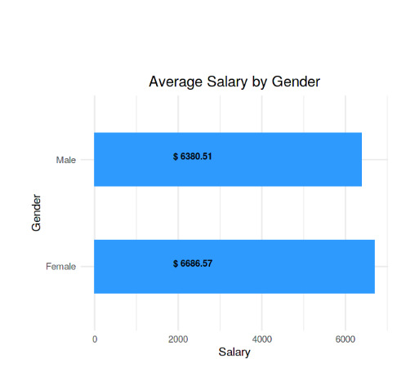


Slide 9
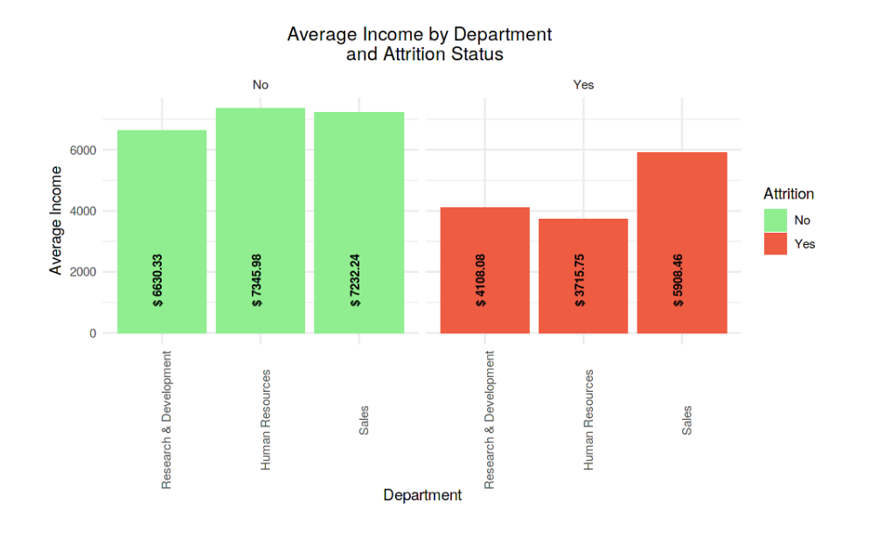
What is the Average Monthly Income per Employee within Each Department

Slide 10
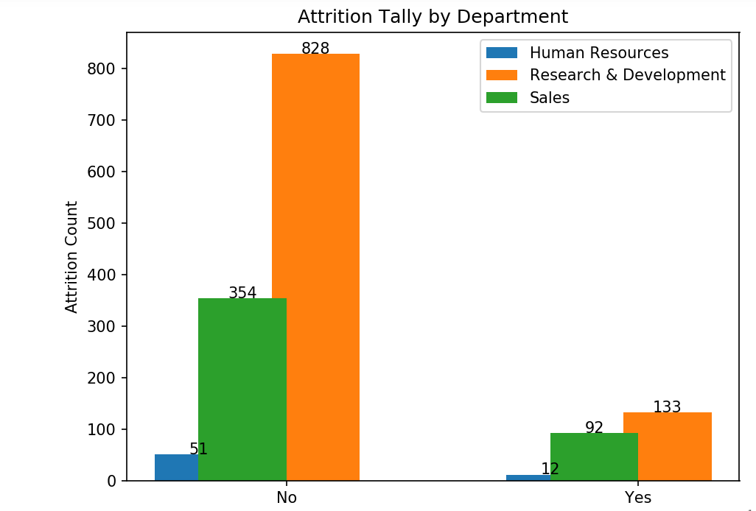
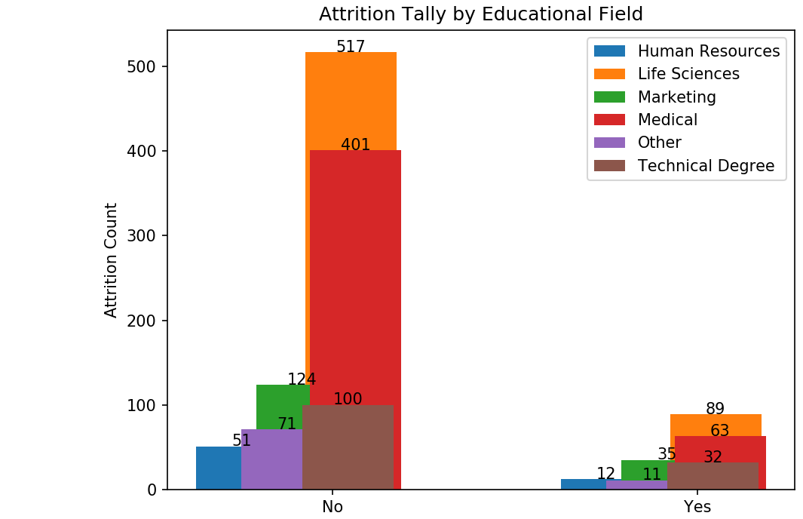

Slide 11
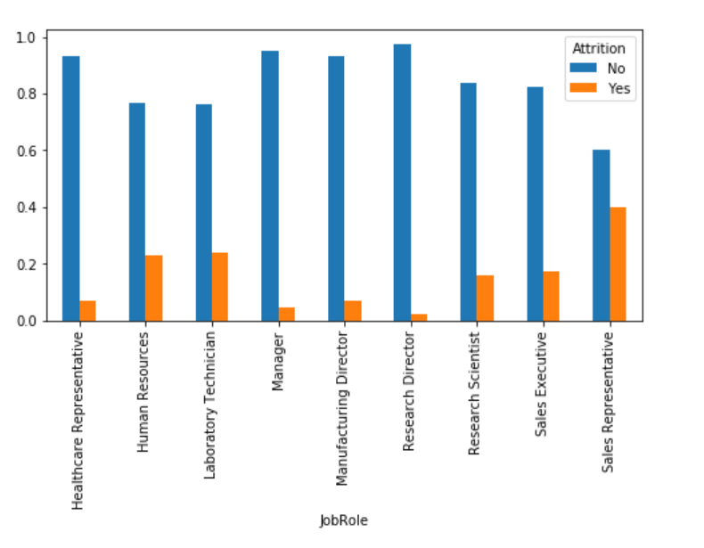
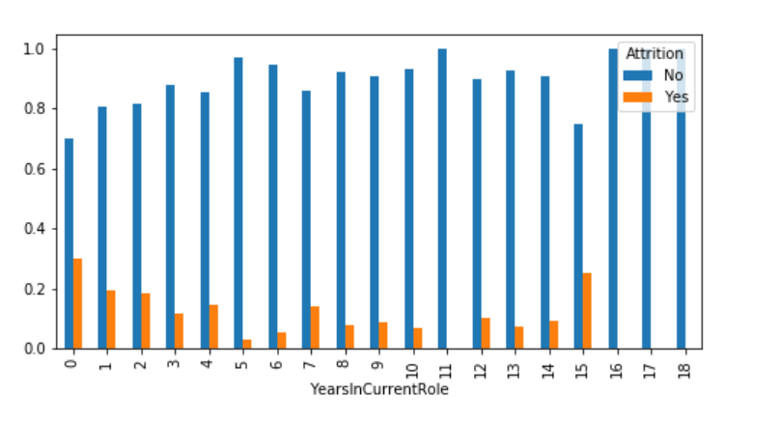

Slide 12
Q&A

